Slide 1




Full Project & Presentation
DEFECTS ANALYSIS REPORT
Hesham Amr
hesham.pebrs@gmail.com
www.linkedin.com/in/hesham-pebrs

Slide 2

Hesham Amr
Agenda
Executive Summary | 3
Introduction | 4
Data Exploration | 5
Data Analysis | 6
Insights and Recommendations | 7
EDA Questions & Answers | 8-12
Dashboards | 13-14
Limitations & Future Work | 10
Conclusion | 16-17

Slide 3

Hesham Amr
Executive Summary
Project Goal:
The primary goal of this project is to analyze defect trends across various materials and vendors, as well as their impact on downtime across different plants. The insights derived aim to optimize production quality and identify key areas for improvement.
Key Findings:
Raw materials and film exhibit the highest defect quantities over the analysis period, with notable spikes in May and October.
Specific vendors, such as Solholdings and Dentocity, have significant defect quantities, which contribute to downtime at plants.
Defects categorized as “Misc” and “Not Verified” dominate the distribution.
Certain plants like Detroit and Springfield exhibit higher defect quantities and downtime, pointing to operational inefficiencies.
Recommendations:
Investigate the root causes of high defect rates in specific vendors and materials, particularly raw materials.
Address process inefficiencies at high-defect plants, starting with the most affected ones.
Back to Agenda

Slide 4
Hesham Amr
Introduction
Background:
This analysis was initiated to understand trends in defect occurrences by material type, vendors, and plant locations. The primary goal is to reduce the defect rate, improve plant efficiency, and streamline vendor selection.
Problem Definition:
High defect rates result in operational inefficiencies and prolonged downtimes at various manufacturing plants, leading to increased costs and reduced output quality.
Data Source and Methods:
The data was collected from defect records spanning from January 1, 2013, to October 10, 2024.
Tools used for analysis included Python for preprocessing and data cleaning, alongside dashboards built to visualize trends.
Back to Agenda

Slide 5
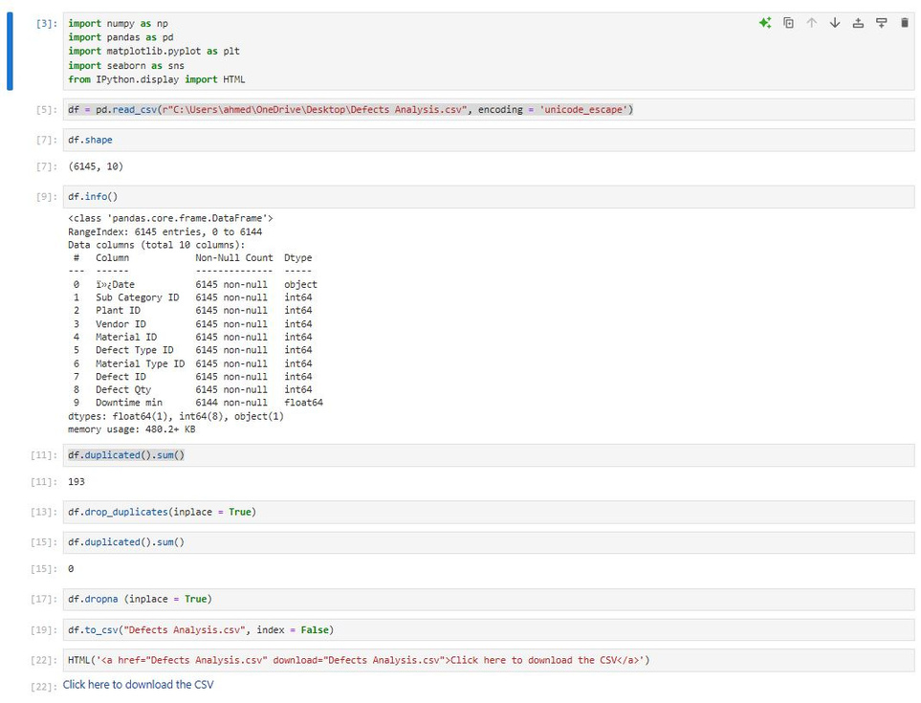

Hesham Amr
Data Exploration
Data Characteristics:
The dataset consists of 6145 rows, each representing a defect occurrence. Key columns include Date, Material Type, Vendor ID, Defect Type, Defect Qty, and Downtime (in minutes).
There were 193 duplicated records, which were removed before analysis. Missing values were also handled
.
Summary Visualizations:
Boxplot for Monthly Defect Trends by Material shows that raw materials have a wide range of defect occurrences.
Line chart for Monthly Defect Trends highlights notable peaks in May and October.
Bar charts and pie charts represent vendor performance and material-specific defect breakdowns.
Data Cleaning: Duplicated rows were removed, and null values in critical columns were filled or dropped.
Back to Agenda

Slide 6

Hesham Amr
Data Analysis
Key Findings:
Defect Quantities by Material: The highest defects are found in raw materials, film, and cartons. These materials need immediate focus to improve the manufacturing process.
Vendor Performance: Vendors such as Solholdings, Dentocity, and Plustax are responsible for the most defects, particularly in molds, labels, and film.
Downtime Analysis:
Reddit and Plustax contribute the most to total downtime.
Plant Locations:
The Detroit, Springfield, and Chicago plants show the highest defect rates and downtimes, indicating potential areas for operational improvements.
Interesting Discovery:
A significant spike in defects and downtime was observed around May and October, which may be related to seasonal or batch-specific factors.
Back to Agenda

Slide 7
Hesham Amr
Insights & Recommendations
Corrugate, Raw Materials and Film: should be prioritized for improvement. These materials are consistently underperforming.
Vendor Optimization: A review of top defect-causing vendors (Solholdings, Dentocity) should be conducted, focusing on renegotiating contracts or enforcing stricter quality control.
Plant-Level Interventions: Plants with the highest defect rates and downtime, such as Detroit and Springfield, need operational audits to uncover inefficiencies and areas for training.
Preventive Maintenance: Implement predictive maintenance strategies based on defect trends to minimize downtime and improve throughput.
Back to Agenda

Slide 8

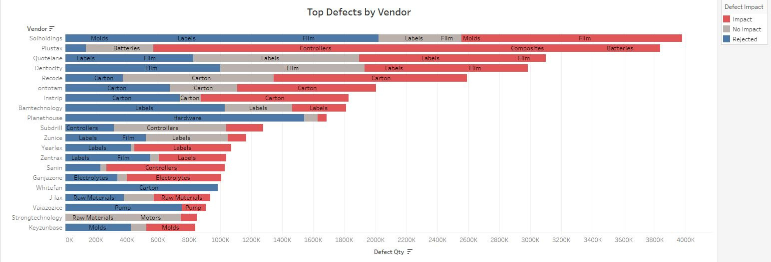
Hesham Amr
EDA Questions & Answers
1. Top Defects by Vendor
Question: Which materials are most frequently associated with defects for different vendors?
Answer: Vendors like Solholdings and Quotelane show a high number of defects associated with Labels and Film, while Plustax and Sanin have frequent defects in Controllers and Batteries, respectively.
Recommendation: Implement stricter quality control for these materials and consider alternate vendors with better performance for Labels, Film, Controllers, and Batteries.
Back to Agenda

Slide 9
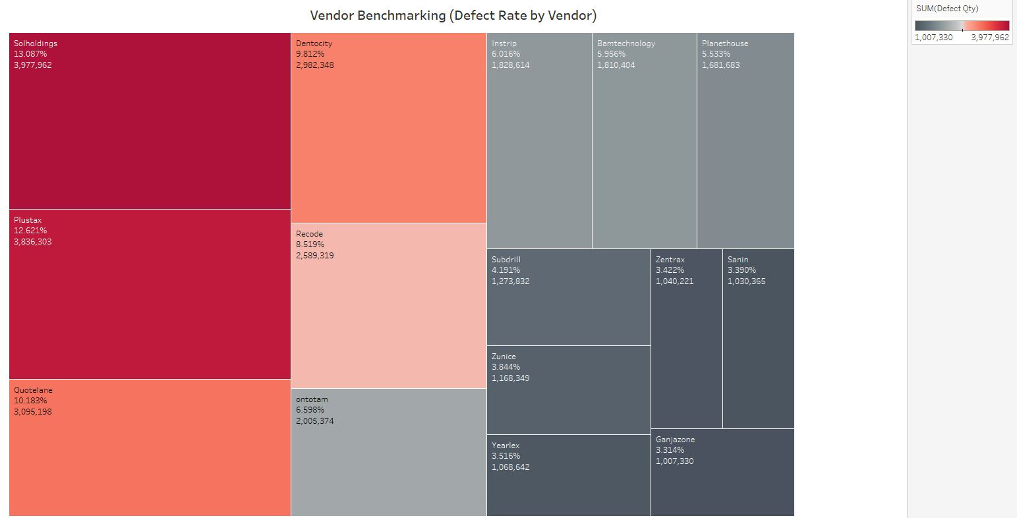
Hesham Amr
EDA Questions & Answers
2. Vendor Benchmarking (Defect Rate by Vendor)
Question:
Which vendor has the highest overall defect rate?
Answer:
Solholdings leads with the highest overall defect rate, with almost 4 million defects, followed closely by Plustax and Dentocity.
Recommendation:
Collaborate with these vendors on improvement plans and consider reducing material purchases until defect rates improve.
Back to Agenda

Slide 10
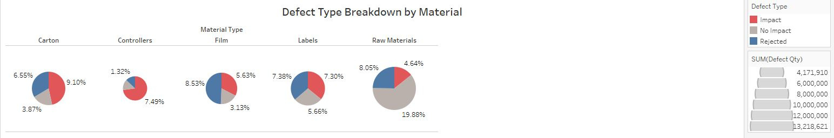
Hesham Amr
EDA Questions & Answers
3. Defect Type Breakdown by Material
Question: What defect type is most common across different materials?
Answer: Impact defects are the most common across multiple materials like Carton and Film, making up the largest proportion of defects when compared to No Impact and Rejected types.
Recommendation: Review transportation and handling practices to reduce impact-related defects, focusing on improving packaging and handling standards.
Back to Agenda

Slide 11
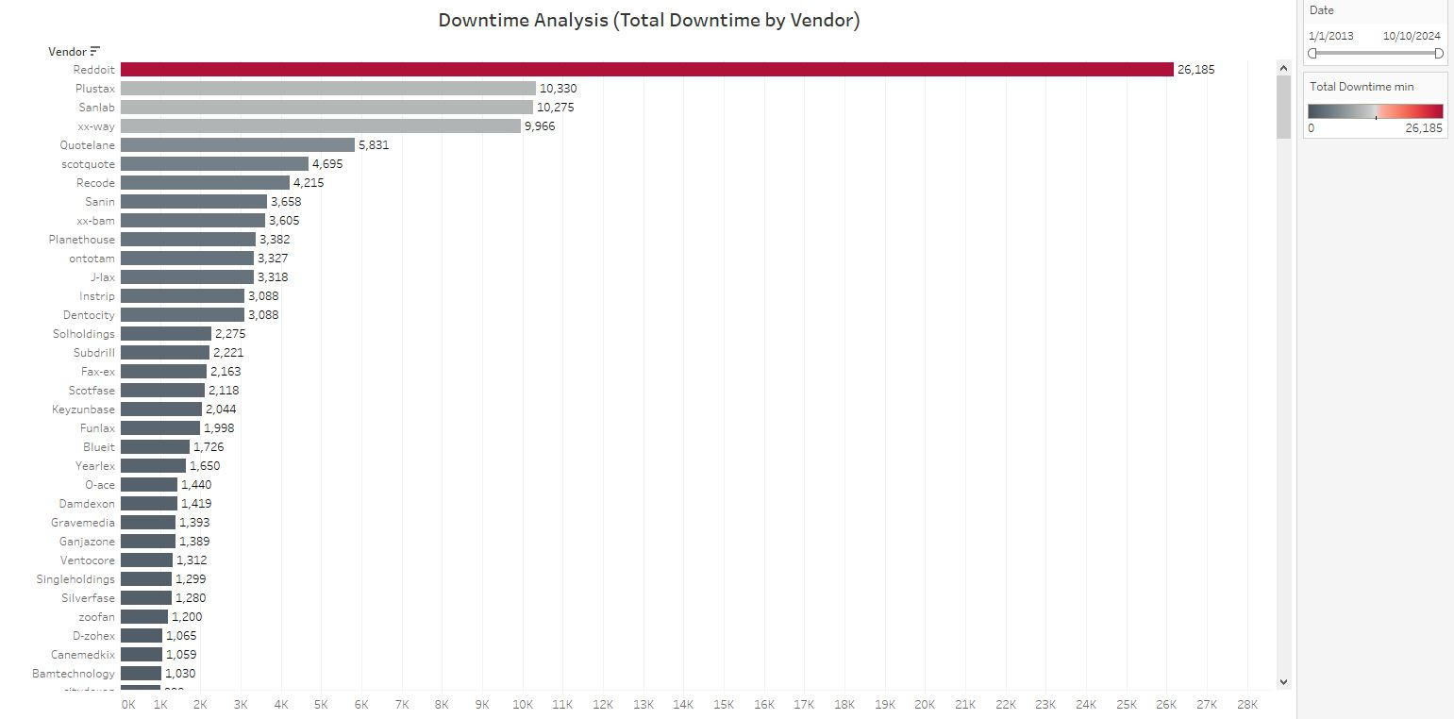
Hesham Amr
EDA Questions & Answers
4. Downtime Analysis (Total Downtime by Vendor)
Question: Which vendor has caused the most downtime due to defects?
Answer: Reddit has caused the most downtime, with
a total of 26,185 minutes, significantly higher than the
next highest vendor, Plustax, which had 10,330 minutes
of downtime.
Recommendation: Address defect sources with
Reddit and consider implementing SLAs or having
backup vendors to reduce downtime.
Back to Agenda

Slide 12
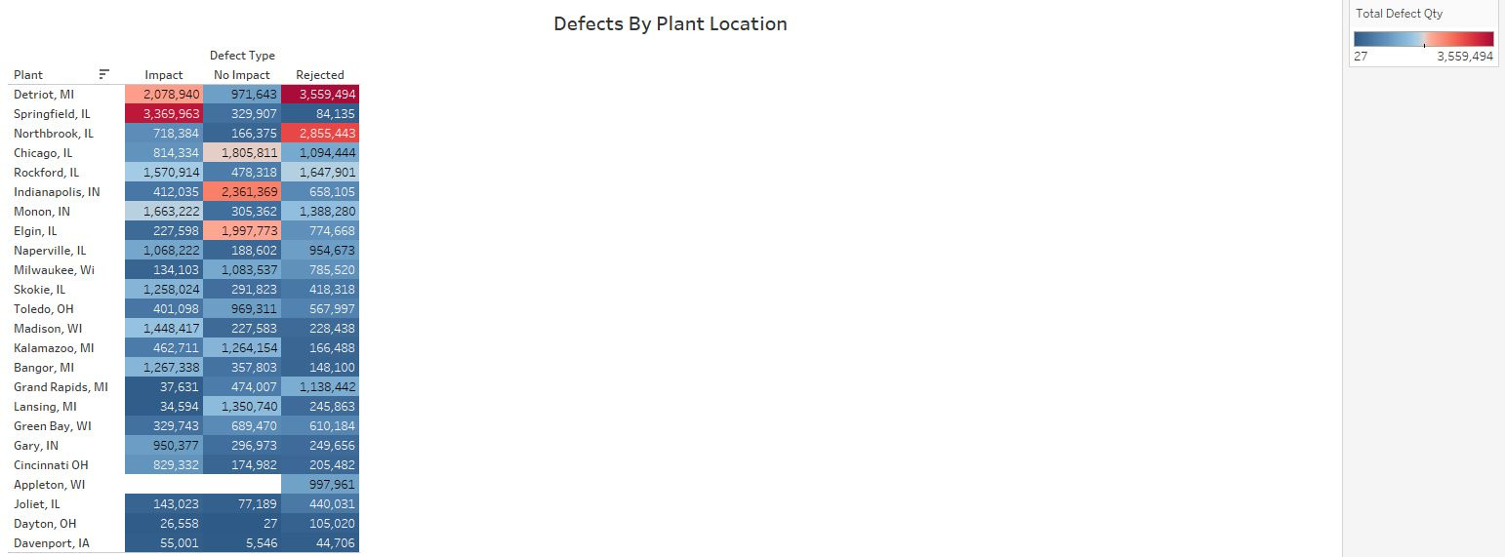
Hesham Amr
EDA Questions & Answers
5. Defects by Plant Location
Question:
Which plant has the highest number of total defects, and how are they distributed by defect type?
Answer:
The Detroit, MI plant has the highest total defects, with 6,578,598 defects. Impact defects account for 2,078,940, while Rejected defects are the largest at 3,559,494.
Recommendation:
Conduct a detailed audit of the Detroit plant and implement process improvements and retraining to reduce rejected defects.
Back to Agenda

Slide 13
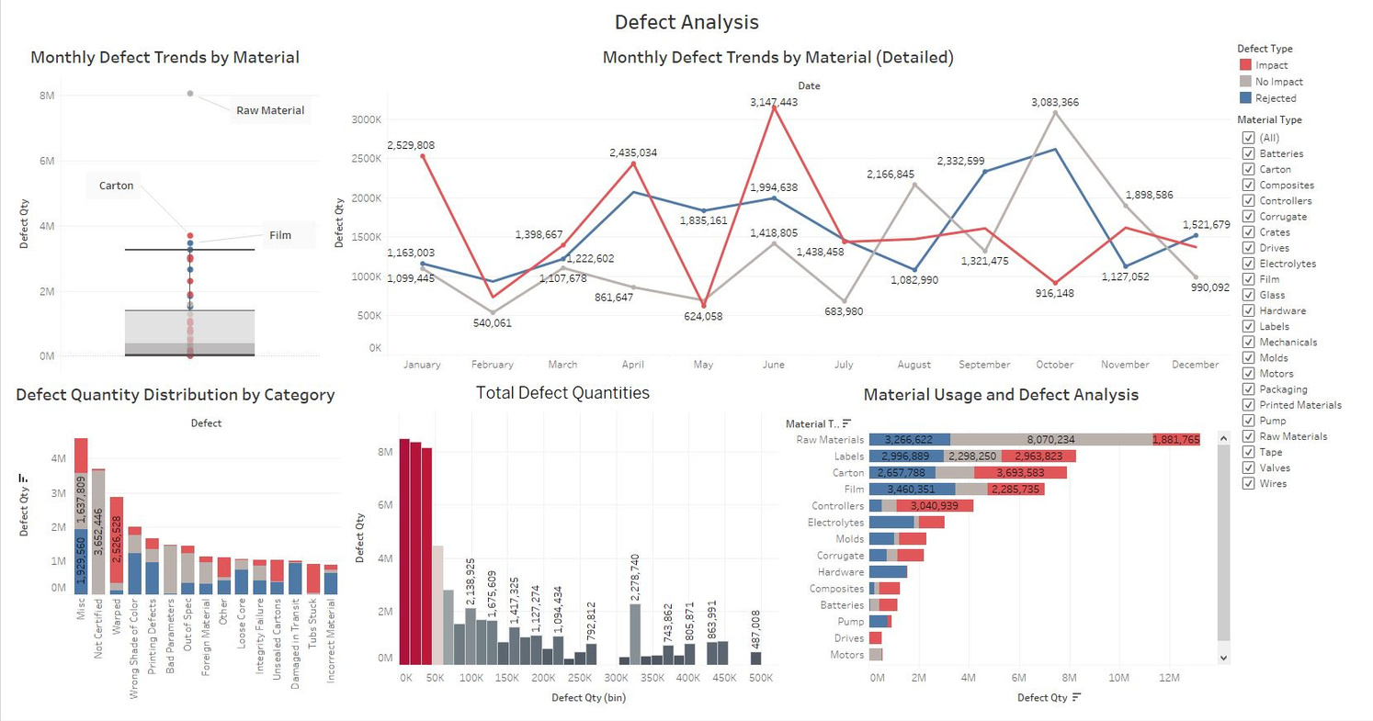

Hesham Amr
Dashboards
Back to Agenda

Slide 14
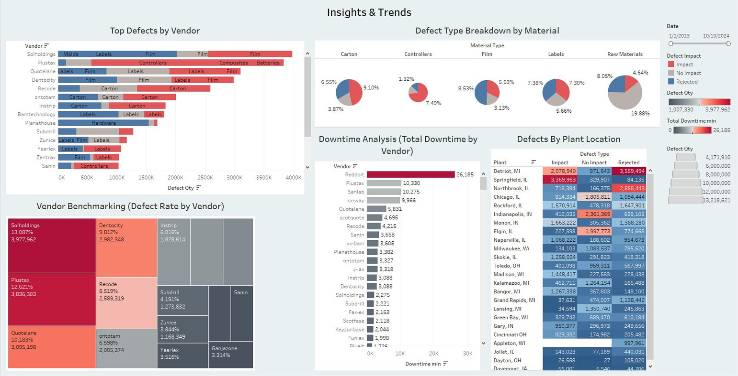
Hesham Amr
Dashboards
Back to Agenda

Slide 15


Hesham Amr
Limitations and
Future Work
Limitations: The analysis relies on available defect data, and potential external factors like supply chain disruptions or operator errors may not be fully captured.
Future Work: Future studies can focus on correlating these defect trends with external factors such as supply chain reliability or seasonality to uncover deeper insights. More granular analysis at the vendor or machine level could also be conducted, And creating ai models to predict defects rates and fix any future issues.
Back to Agenda

Slide 16
Hesham Amr
Conclusion
Raw materials and film have the highest defect rates.
Vendors like Solholdings and Dentocity contribute significantly to downtime.
Detroit and Springfield plants show notable operational inefficiencies.
Key focus areas: improve material quality, optimize vendor performance, and audit high-defect plants to reduce downtime and boost productivity.
Back to Agenda

Slide 17

Full Project & Presentation
DEFECTS ANALYSIS REPORT
THANK YOU FOR YOUR TIME! AND THANK YOU Eng. Yasser Abd Al-Rahman For your teachings and efforts
Hesham Amr
hesham.pebrs@gmail.com
www.linkedin.com/in/hesham-pebrs

